Slide 1


In the name of God, the Most Gracious, the Most Merciful

Slide 2

Project presentation
Bouncing ball

Slide 3

Group members
Group no 7
Musa bin Abdullah (233576)
Hassan Ali (233542)
Ali Asif (233562)

Slide 4

BOUNCING BALL
1. Users uses the arrow keys to play, providing a simple interface for players of all ages.
2. Realistic bouncing mechanics simulate the natural movement of a ball, enhancing the game's realism .
3. Points are awarded for every successful bounce, motivating players to achieve higher scores .
4. The game features a visually appealing background that changes as the player advances .

Slide 5
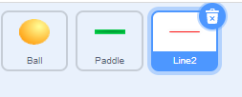
ADD SPIRITS :
1
SPIRIT AS GIVEN BELOW :
BALL
PADDLE
LINE AT THE END

Slide 6
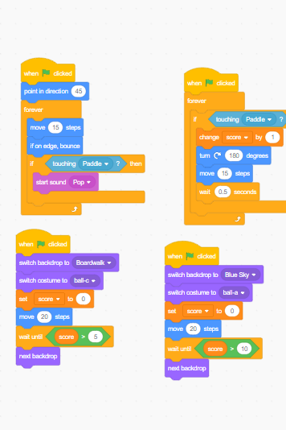

2
ADDING CODE :
ADDING CODE IN SCRATCH FOR THE SPIRIT BALL
If else condition .
User defined variables.
And other events.
Adding the code to bounce in other direction when touch paddle
And stop when touch red line.

Slide 7
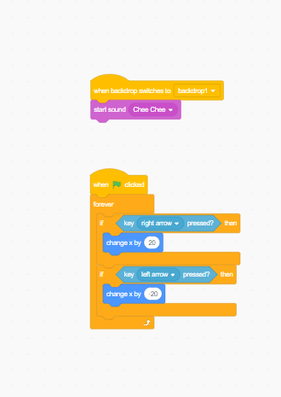

3
ADD CODE :
ADD CODE IN PADDLE SPIRIT.
Adding the controls to the paddle as arrow left and right.

Slide 8
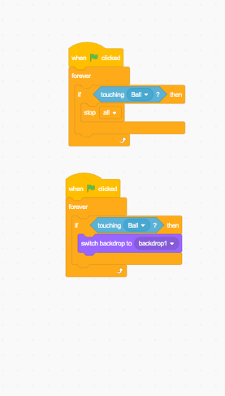
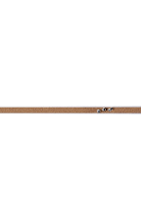

4
ADD CODE :
ADDING CODE IN LINE EDGE.
Code to stop the game when ball touches the red line

Slide 9
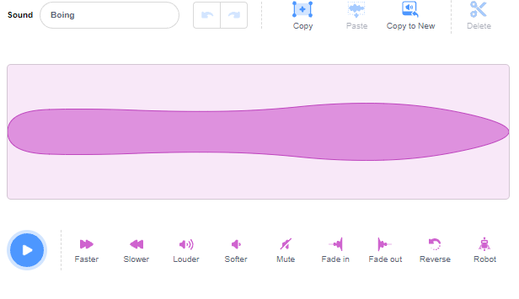
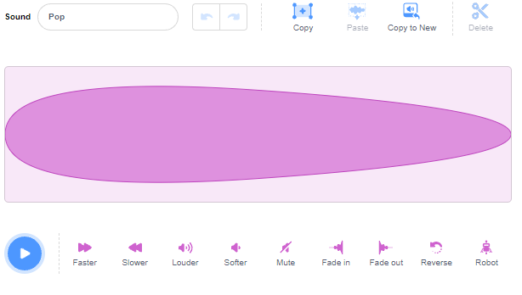
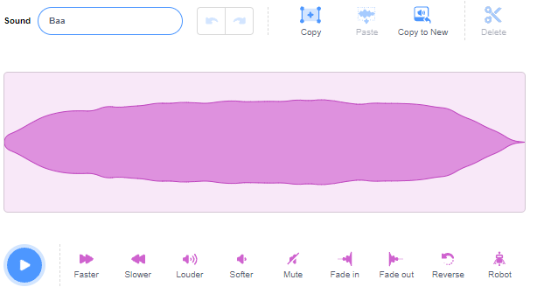
5
Adding voice note
ADD CODE :
ADDING sounds in the backdrops and spirits.
As when the ball touch the paddle.
And when the ball touch red line then which voice note should come .

Slide 10
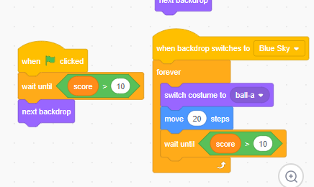
Backdrops coding :
6
For background ,three backdrops are added for three levels so that it can be made for fun for the player and changing the costume of spirit too.
Also the speed is also increased by additional moves
Also the coding for the you win.

Slide 11
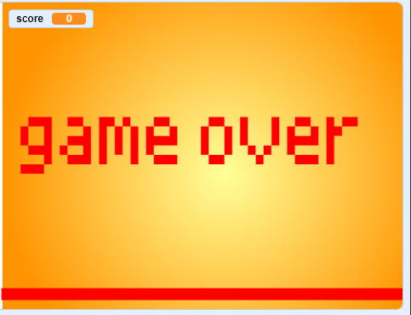
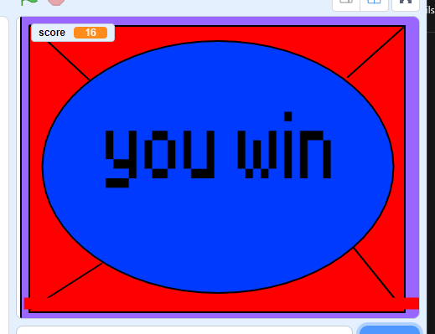
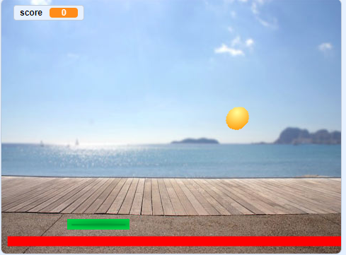
Result :
7

Slide 12


